Slide 1
LIGHTNING OVERVOLTAGE ANALYSIS FOR A 500 kV SUBSTATION
Melih GÜNERİ

Slide 2
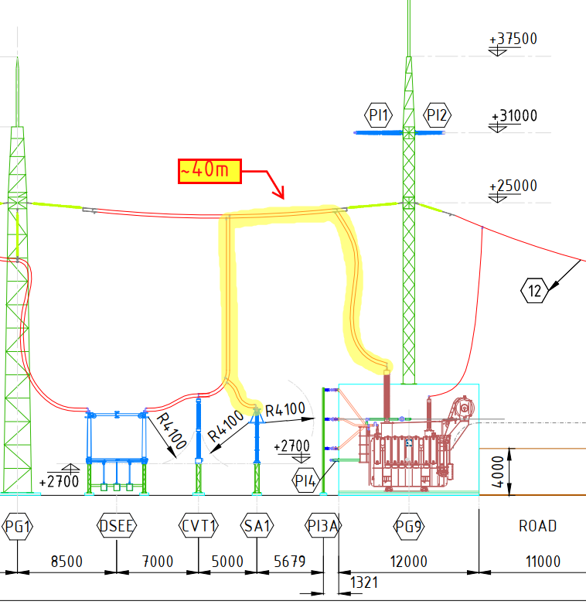
Introduction & Problem Statement
This presentation is about a case study of lightning overvoltages analysis for a 500/220 kV substation.
Problem statement:
Direct connection between transformer and surge arrester was not possible
~40 m electrical distance might have compromised the overvoltages protection provided by the surge arrester
Voltage build-up on the conductor would be important at high frequencies. Thefore, lightning overvoltages analysis was conducted

Slide 3
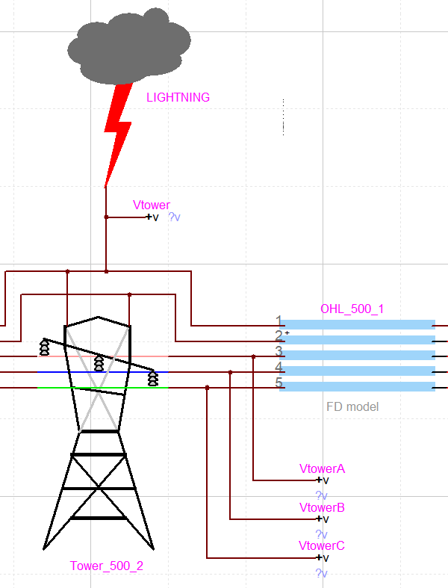
Methodology
It is assumed that the substation is well protected against lightning strikes. A lightning surge can propagate to the substation only from OHL.
Lightning strikes can affect OHL in three ways:
  Induced O/V → N/A (related to distribution level)
  Back flashover
  Shielding failure
Procedure:
  Lightning flash modeling
  Tower modeling
  Surge arester modeling
  Conductor modeling
  HV apparatus modeling
  Simulations in EMTP

Slide 4
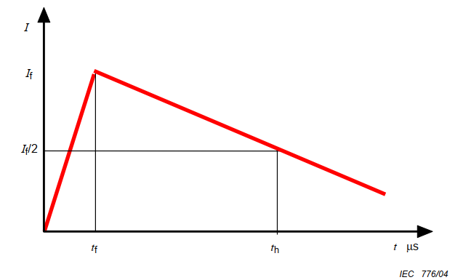
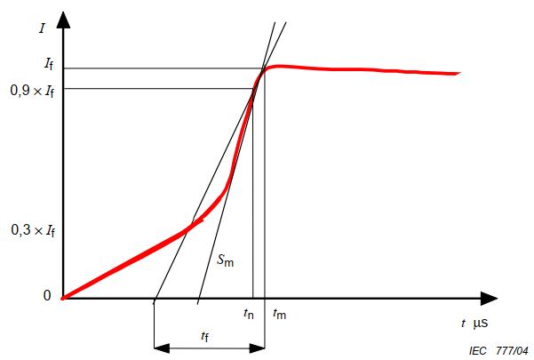
Modeling
Lightning flash modeling – Selection of main parameters
Lightning flash model depend on several main parameters
  Downward / upward flash
    Upward flashes occur mainly from very tall structures
    Downward flashes are considered
  Positive / negative flash
    Positive flashes are experienced typically 10% or less
    The more prevalent negative flashes are considered
  Return stroke / subsequent strokes
    The amplitude of subsequent strokes tend to be significantly lower
    Return strokes are considered (first stroke)
  Waveshape
    Waveshape can be either «double ramp» or «Cigre concave»
    CIGRE concave shape usually gives more realistic results [2]
Downward negative first stroke with CIGRE concave shape
Double ramp shape [2]
CIGRE concave shape [2]

Slide 5
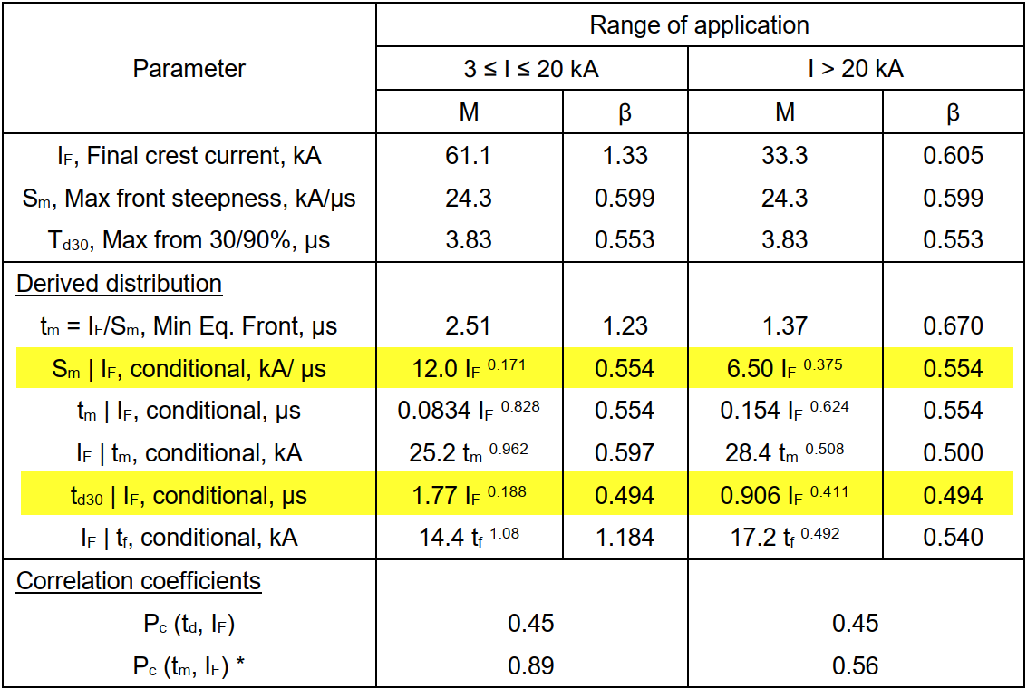
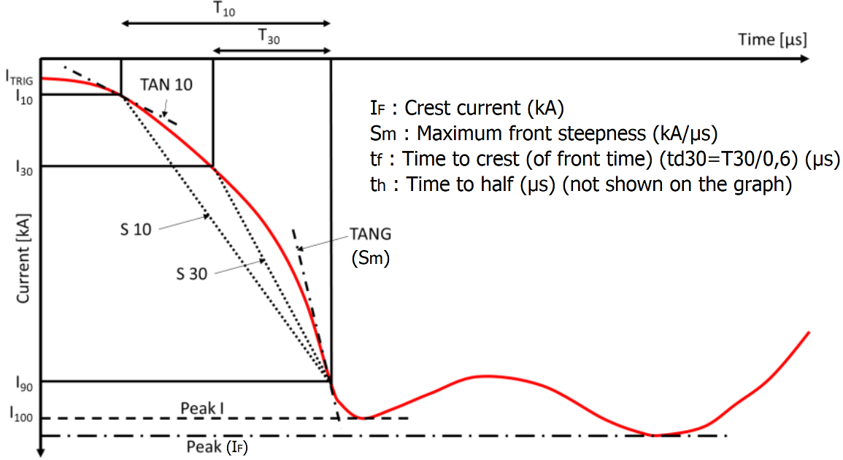
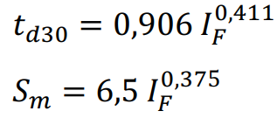
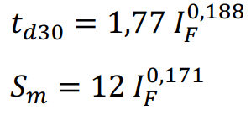
Modeling
Lightning flash modeling – Calculation of parameters
CIGRE concave shape can be specified mainly with:
  Crest current (I_{F}) (kA)
  Maximum front steepness (S_{m}) (kA/μs)
  Time to crest (or front time) (t_{d30}=T₃₀/0,6) (t_{f}) (μs)
  Time to half (t_{h}) (μs)
Lightning parameters are specified statistically
I_{F} should be calculated for BF and SF, seperately
Median values can be used for S_{m} and t_{f} [1]
S_{m} and t_{f} can be calculated from I_{F} [1]
t_{h} is not critical, 77,5 μs can be used [1]
First negative downward stroke parameters (Table 3-9 from [1])
Median values for back flashover
Median values for shielding failure
CIGRE concave shape (modified from Fig 3-1 from [1])

Slide 6
Modeling
Lightning flash modeling – Crest current (I_{F}) for back flashover
Overvoltage on the tower resulting from the lightning current passing through it may result in «back flashover» on the line insulator
Increasing «lightning crest current" increases the possibility of "back flashover"
It does not make economic sense to protect S/S equipment against all probable lightning currents. For this reason, an acceptable failure rate is specified.
  IEC 60071-2: between 1/250 years and 1/1000 years [3]
Crest current for the analysis should be selected, such that, probability of encountering an actual crest current over this level should be lower than the acceptible failure rate
  If the S/S equipment can withstand this value, it is acceptible even if they fail for currents over it
Selection process of crest current is iterative:
  Select a crest current (max: 200 kA [1])
  Calculate probability of exceeding this value
  If calculated probability is out of acceptible range, select another value

Slide 7
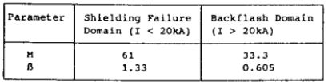

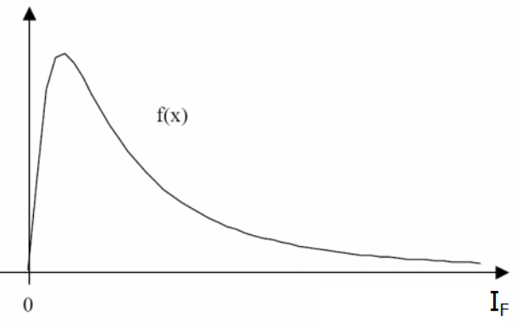
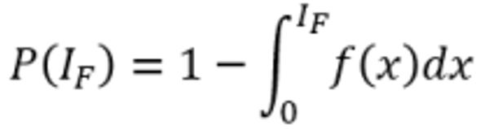

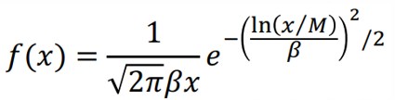


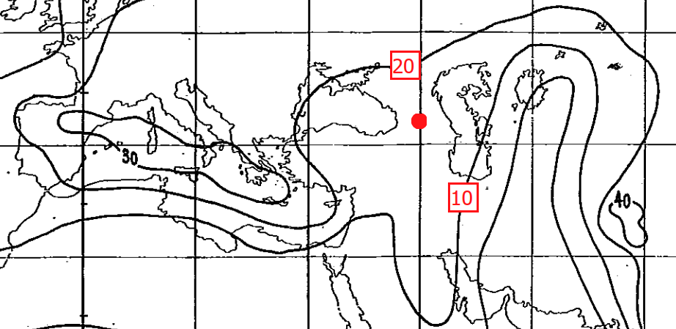
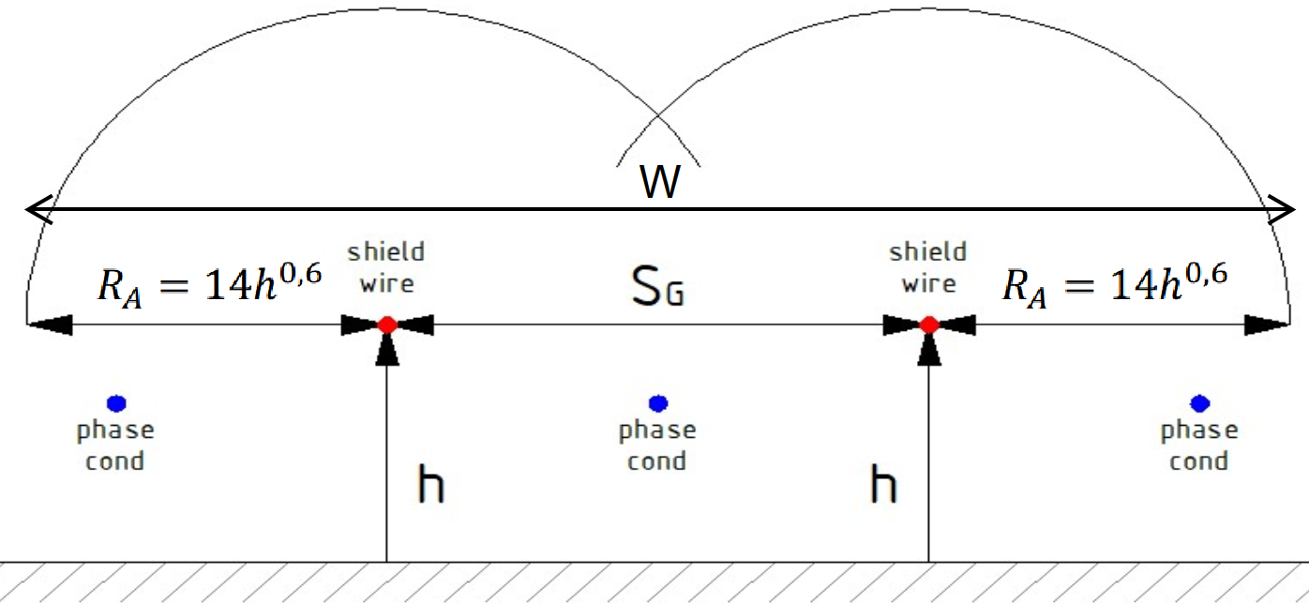
Modeling
Lightning flash modeling – Crest current (I_{F}) for back flashover
Probability of exceeding selected crest current value:
Log normal parameters (Table 3-2 from [1])
Number of OHL’s
Probability of lightning current > I_{F}
Ground flash density
Limit OHL distance
Exposed width of the OHL
Keraunic level map (Td) (Table 3-2 from [4])

Slide 8
Modeling
Lightning flash modeling – Crest current (I_{F}) for back flashover
Limit OHL distance
  Basically, this is the section of the OHL to be considered in the analysis
  Select I_{F} = 200 kA, and find with simulation the distance X_{p} , not resulting in failure in the S/S
  Calculate I_{F} with this X_{p}
  Calculate new X_{p} with this I_{F}
Or, define a common value for a minimum limit OHL distance
  2,5 span of OHL [3]

Slide 9
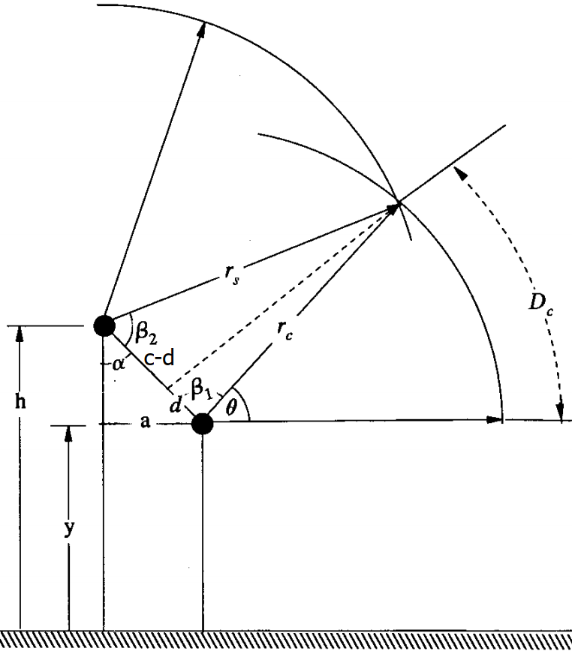
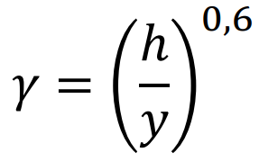
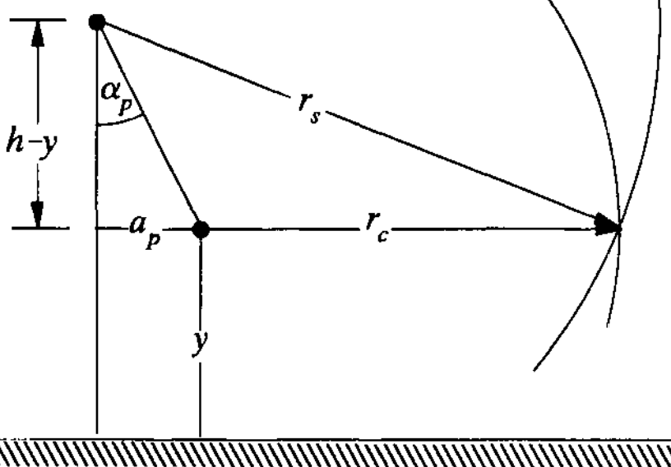
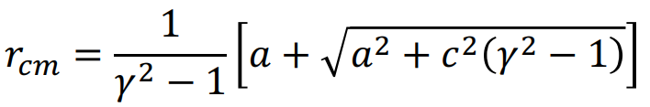
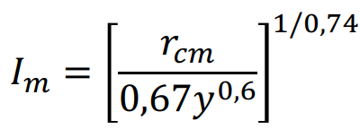
Modeling
Lightning flash modeling – Crest current (I_{F}) for shielding failure
Conductors have striking distances dependant on I_{F}
For low I_{F} values, there is an arc (D_{c}) for strike to the line conductor
Striking distance to a conductor increases with increasing I_{F}
After a certain I_{F} level (I_{m}), the arc D_{c} diminishes.
If S/S equipment can withstand this max I_{F} level (I_{m}), then there is no need for further probabilistic assessments.
Shielding failure (Ch7-Fig10 from [5])
Perfect shielding (Ch7-Fig11 from [5])
Ref. for formulae: [5]

Slide 10
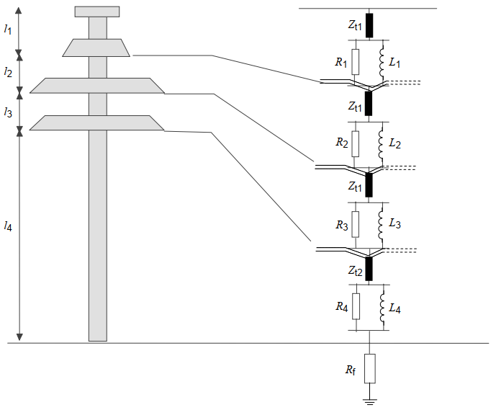
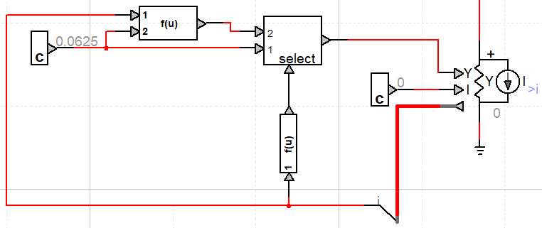

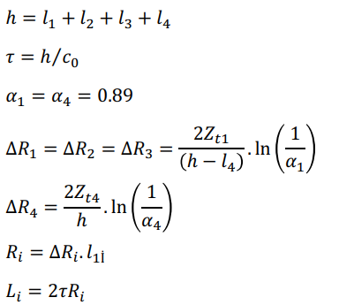


Modeling
Tower modeling
Multi story parameter model is implemented (for 500 kV tower)
  This model is applicable to the main body of the tower. Crossarms on tower will be modeled as lumped inductive elements with 1 μH/m
Tower footing resistance is modeled with soil ionization
Line insulators are modeled with voltage controlled ideal switch
Multi story tower model (Fig11 from [2])
Ref. for formulae: [2]
Tower footing resistance model in EMTP
Ref. for formula: [3]
Ref. for formulae: [6]

Slide 11
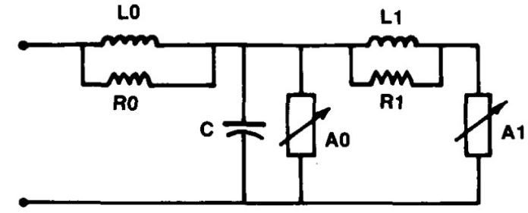


Modeling
Surge arrester modeling
Surge arresters are represented with frequency dependent model described by IEEE WG 3.4.11 [7]
Surge arrester model provided in EMTP is used
Surge arrester model (Fig1 from [7])

Slide 12
Modeling
Other modeling considerations
Overhead lines
  Frequency dependent line model is used
Tubular busbars
  Frequency dependent line model is used
Short conductors between HV apparatus
  Constant parameter line model is used (R=1 mΩ, Zc=250 Ω, v=3x10⁸ m/s)
Other short connections
  Lumped inductance with 1μH/m is used
HV apparatus (CB, DS, CT, VT, etc.)
  Modeled with capacitances
  Manufacturer data is used when available. Else, typical data given in [2] are used

Slide 13
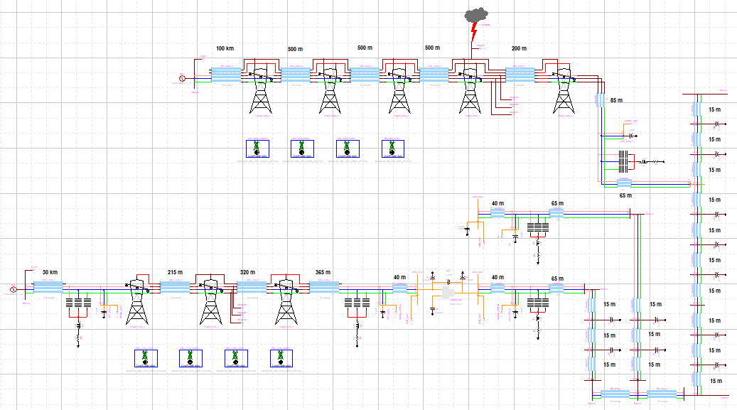
Modeling

Slide 14


Simulations
Several cases have been analyzed in order to investigate any possible fast front overvoltages that may travel into the substation as a result of lightning incidences on overhead lines
  CASE 1 - Back flashover analysis for 500 kV (surge applied to second tower)
  CASE 2 - Shielding failure analysis for 500 kV (surge applied to first tower)
  CASE 3 - Back flashover analysis for 220 kV (not presented here)
  CASE 4 - shielding failure analysis for 220 kV (not presented here)
Acceptable limits for lightning overvoltages will be taken as lightning impulse withstand voltage level (LIWV) of apparatus divided by a safety margin (Ks).
  Following the recommendation in IEC 60071-2 [3], safety margin was taken as 1,15
  Acceptable limits for lightning overvoltages:
For 500 kV system
For 220 kV system

Slide 15
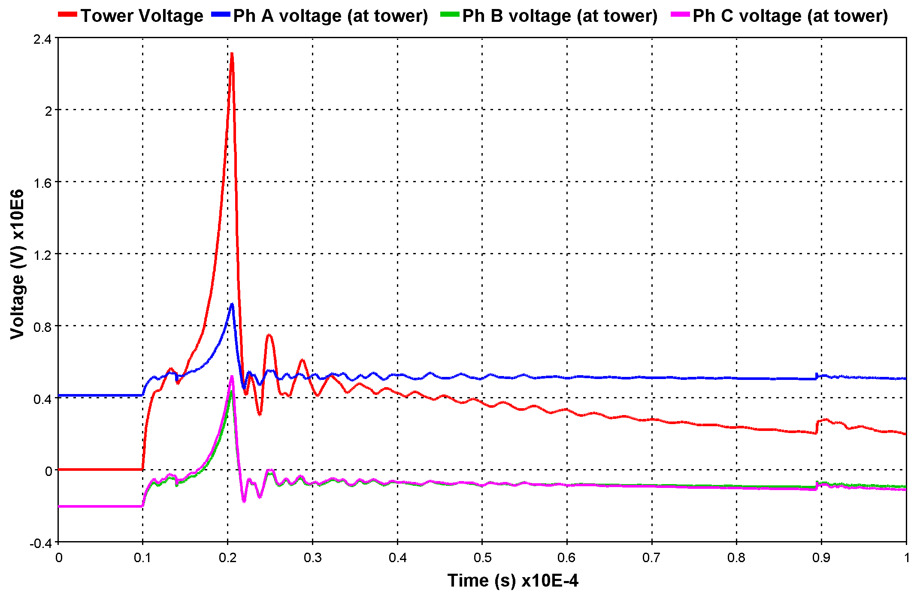
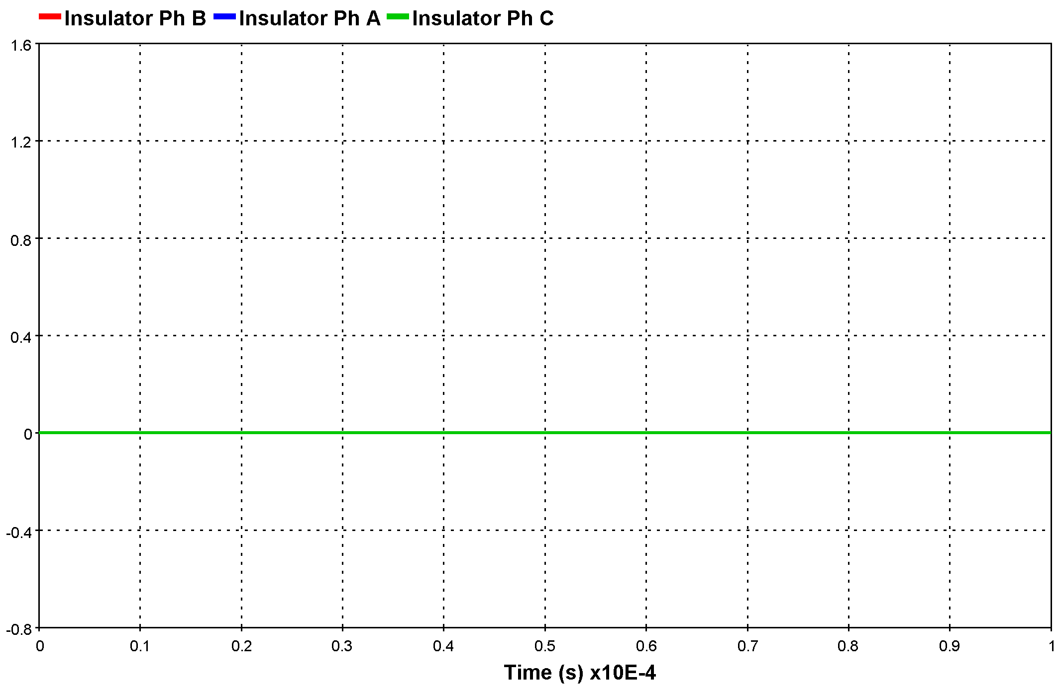
Simulations
CASE 1 – Back flashover analysis for 500 kV
Calculated waveform for BF (I_{F}=150 kA, S_{m}=44,8 kA/μs, t_{f}=7,1 μs) has been applied
  No flashover has been observed in any phase
  Changing source phase angle didn’t result in any flashover

Slide 16
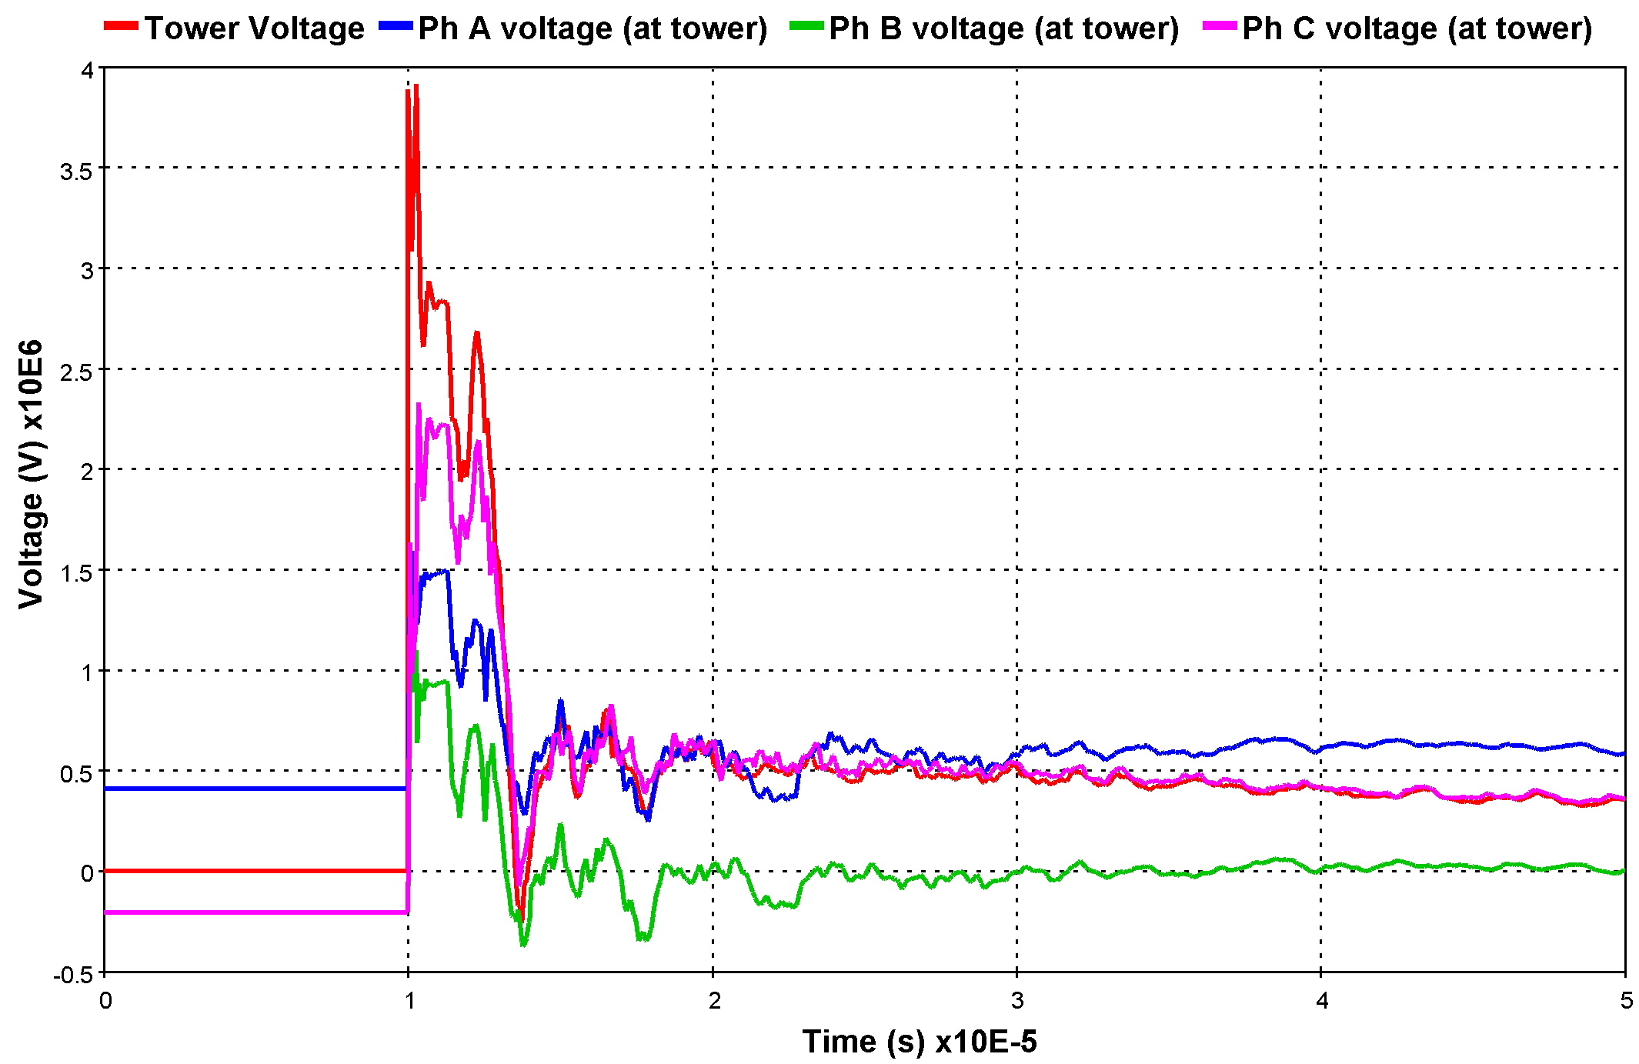
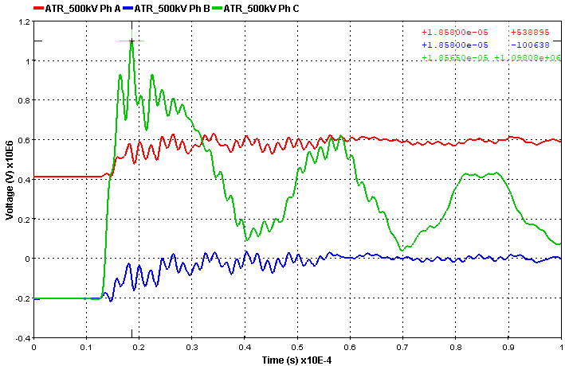
Simulations
CASE 1 – Back flashover analysis for 500 kV
Front time has been decreased (t_{f}=3 μs) to create a flashover
  Flashover has been observed in phase C
  Maximum voltage on ATR bushings is 1098 kV (on phase C), which is lower than the limit
  Changing source phase angle didn’t result in higher voltages at ATR bushings

Slide 17
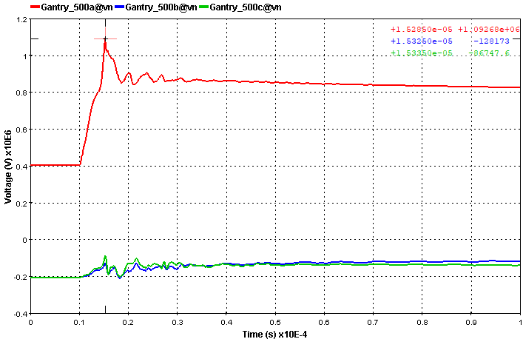
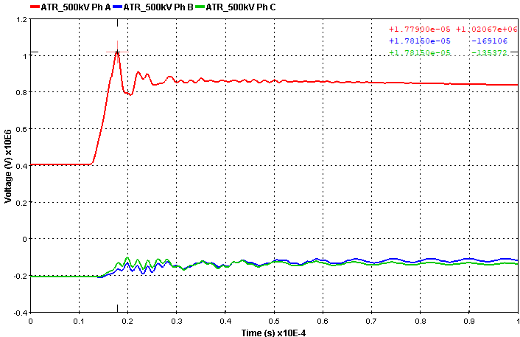
Simulations
CASE 2 – Shielding failure analysis for 500 kV
Calculated waveform for SF (I_{F}=17 kA, S_{m}=19,5 kA/μs, t_{f}=3,0 μs) has been applied on Ph A
  Maximum voltage on gantry and ATR bushing are 1092 kV and 1020 kV, respectively, which are lower than the limit
  Changing striken phase didn’t result in higher voltages at ATR bushings

Slide 18
Conclusions
Lightning overvoltages analyses have shown that, maximm overvoltages expected on ATR bushing are lower than tolerable voltages, both for back flashover case and shielding failure cases.
Placement and rating of surge arresters are adequate for providing necessary protection to the transformer

Slide 19
References
[1] Cigre SC33/WG01, TB 63, Guide to Procedures for Estimating the Lightning Perf. of TL's, CIGRE, 2021 (updated)
[2] IEC TR 60071-4 (Ed 1.0), Insulation Coordination - Part 4: Computational guide to insulation co-ordination and modelling of electrical networks, IEC, Geneva, 2004
[3] IEC 60071-2 (Ed 3.0), Insulation Coordination - Part 2: Application guide, IEC, Geneva, 1996
[4] World Distribution of Thunderstorm Days, Part 2 - Table of Marine Data and World Maps, WMO, 1956
[5] Hileman A., Insulation Coordination for Power Systems, 1st Ed., CRC Press, Boca Raton, 1999
[6] Ametani A., Kawamura T., A Method of a Lightning Surge Analysis Recommended in Japan Using EMTP, IEEE Trans. on Power Delivery, 2005, vol. 20, no. 2, pp. 867 - 895
[7] "Modeling of metal oxyde surge arresters" – IEEE working Group 3.4.11 – IEEE TPD, Vol 7, January 1992

Slide 20
THANK YOU!

